Slide 1
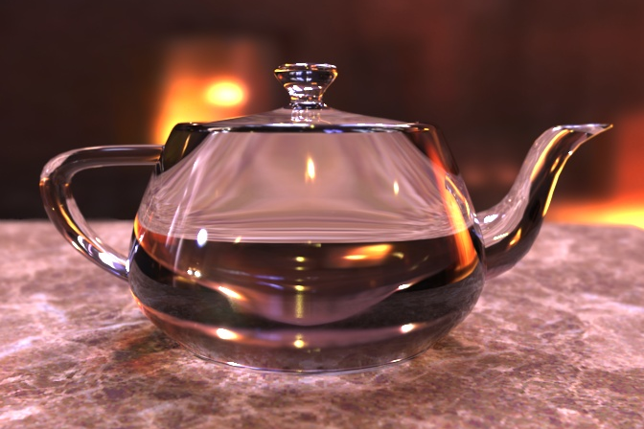
Computer Graphics
林文杰, Wen-Chieh (Steve) Lin
www.cs.nctu.edu.tw/~wclin
Department of Computer Science &
Institute of Multimedia Engineering
Teapot by Henrik Jensen

Slide 2
Course Goal
Provide you enough fundamentals to study or do computer graphics research
Breadth > Depth
Independent study / Self-learning

Slide 3
Course Outline—Fundamentals
Overview
Graphics primitives (raster algorithms)
Transformation
Viewing
Hidden surface removal
Shading
Texture mapping
Curves and surfaces

Slide 4
Course Outline—Intermediate/Advanced
Topics to be determined …
For example
Ray tracing
Global illumination
Subdivision surface

Slide 5
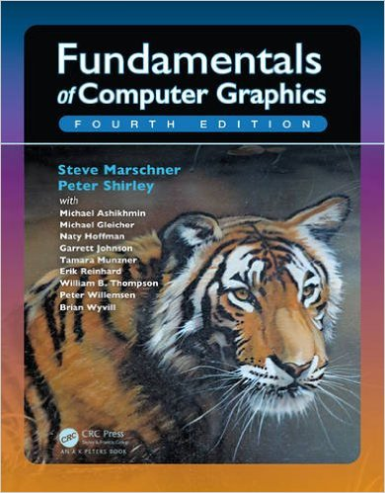
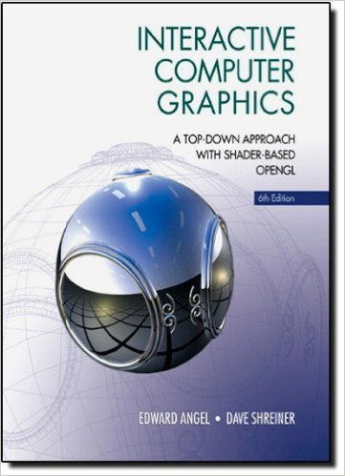
No Textbook
Course slides mainly based on
Steve Marschner & Peter Shirley, Fundamentals of Computer Graphics, 3rd/4th Ed., A K Peters
Angel & Shreiner, Interactive Computer Graphics, 6th Ed., Addison-Wesley

Slide 6
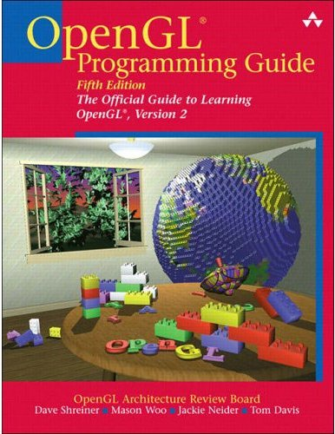
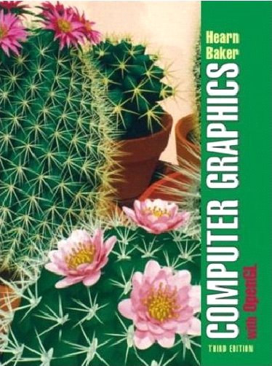
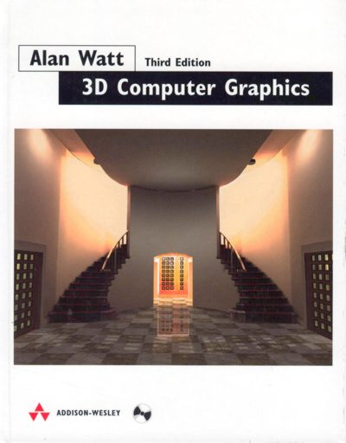
References
OpenGL Programming Guide, Addison-Wesley
Hearn & Baker, Computer Graphics with OpenGL, Prentice Hall
Alan Watt, 3D Computer Graphics, 3rd Ed., Addison Wesley

Slide 7
Major CG Conferences and Journals
Conferences
SIGGRAPH
SIGGRAPH Asia
Eurographics
Eurographics Symposium on Rendering (EGSR)
Symposium on Computer Animation (SCA)
Symposium on Interactive 3D Graphics and Games (I3D)
Useful web: http://kesen.huang.googlepages.com/
Journals
ACM Transactions on Graphics
IEEE Transactions on Visualization and Computer Graphics

Slide 8
Related Courses
Computer animation and special effects
3D game programming
Real-time rendering
Image-based modeling and rendering
Texturing techniques
Image processing
Computer vision

Slide 9
Administration
Office hours: Tue 10:00 — 11:00 AM
Course web: E3 http://e3new.nctu.edu.tw/
contact us if you cannot access the web
My email: wclin@cs.nctu.edu.tw
Teaching Assistants
李一凡 louis890404@gmail.com
成文瑄 wenxuan1125@gmail.com
田竹穎 qaz849030@gmail.com

Slide 10
Grading
2 Programming assignments (50%)
3rd Programming assignment or Midterm exam in Dec. (25%)
Final project (25%)
Proposal due in mid Nov
Final demo in Jan
Paper study / presentation (10%)
Paper/topic should be approved by the instructor
Class participation (5%)

Slide 11
Late and Cheating Policies
Late policies
Turn in by 11:59 PM of the due date
Penalty of 10 points of the value of the assignment per late day
Cheating policies
0 points for any cheating on assignments or exams
Allowing another student to examine your code is also considered as cheating

Slide 12

Any question?

Slide 13
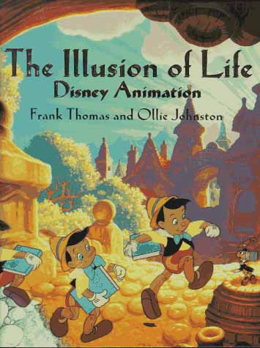
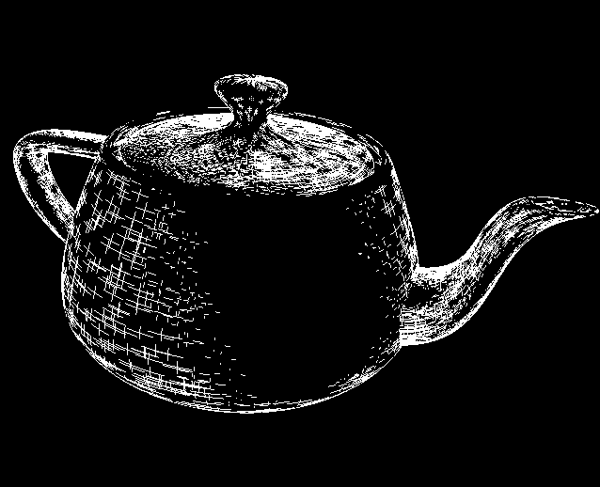
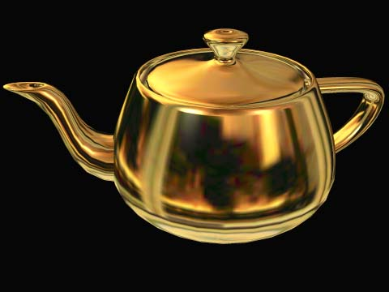
What is computer graphics?
“Any use of computers to create or manipulate images”
Digital “illustration of life”

Slide 14
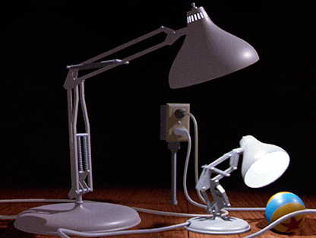
Luxo Jr.
Pixar’s first film, 1986
Notes:
Lasseter's aim was to finish the short film for the 1986 SIGGRAPH, an annual computer graphics conference attended by thousands of industry professionals. The film would come from his experiments with modeling his Luxo lamp. Lasseter worked to improve the story within the allotted two minutes. In animation, the film demonstrates the use of shadow maps within the rendering software. Lasseter applied the classic animation principles popularized by Disney's Nine Old Men to convey the lamps' emotions. Catmull and Lasseter worked around the clock, and Lasseter even took a sleeping bag into work and slept under his desk, ready to work early the next morning.^{[1]} In total it took about four and a half months to do.^{[2]}
Luxo Jr. is regarded as a breakthrough in the animation medium as a whole, changing traditionalists' interpretation of computer animation. The short was the first work of animation to use procedural animation, the software written by Eben Ostby.^{[4][5]} It received an Academy Awardnomination for Best Animated Short Film, becoming the first CGI film nominated for an Academy Award.

Slide 15
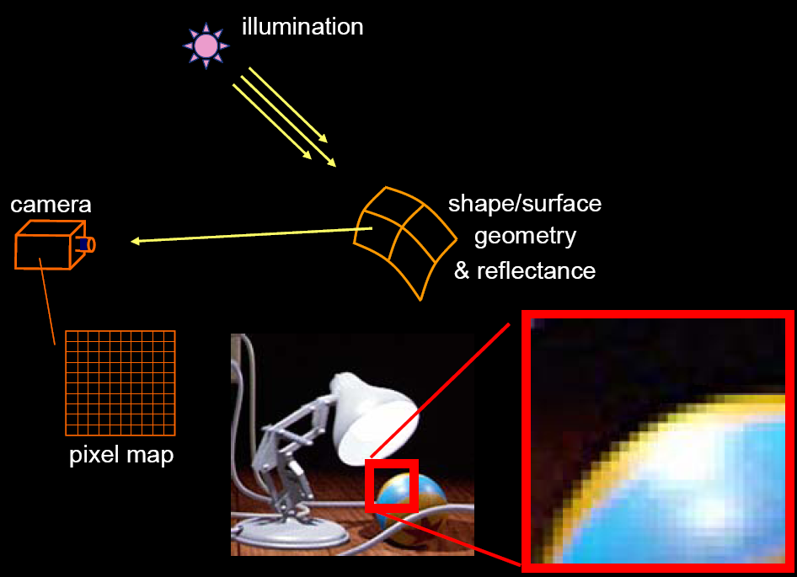
How are images generated?

Slide 16
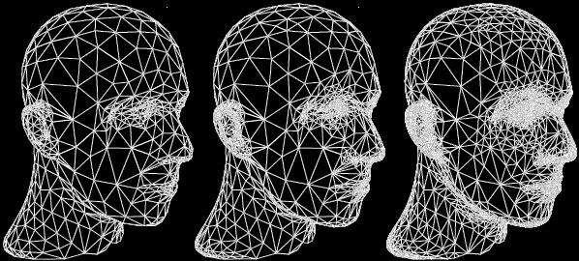
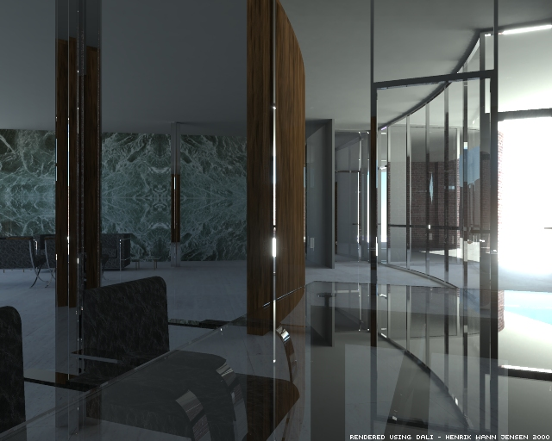
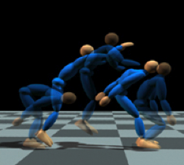
Areas of computer graphics
Geometry (Modeling)
Rendering
Motion (Animation)
Zorin et al. SIGGRAPH’97
Jensen, SIGGRAPH 2000
Liu & Popović , SIGGRAPH’02
Notes:
Ludwig Mies van der Rohe, along with Walter Gropius and Le Corbusier, is widely regarded as one of the pioneering masters of modern architecture

Slide 17
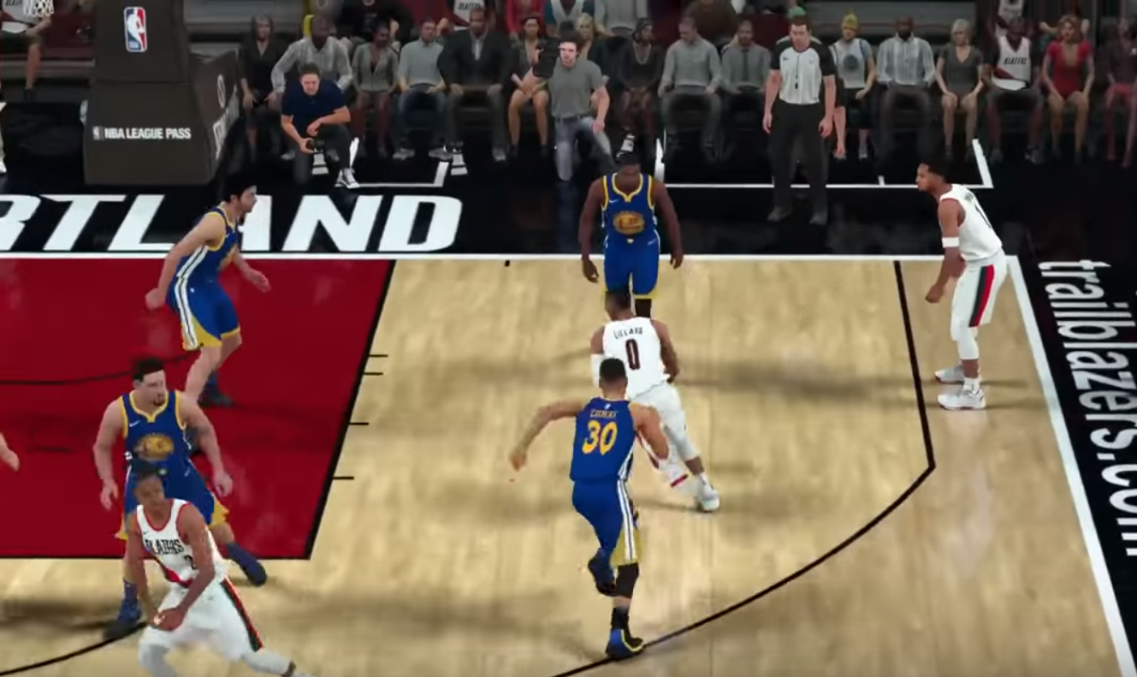
Applications of Computer Graphics
Film special effects
Animation
Video games
CAD/CAM/3D printing
Simulation
Medical imaging
Scientific & Information visualization
https://youtu.be/kU_CBMNVUwg

Slide 18
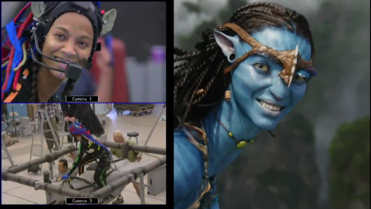
Film Special Effects: Avatar

Slide 19

Notes:
http://s2016.siggraph.org/production-sessions/sessions/industrial-light-magic-presents-visual-effects-star-wars-force-awakens
The ILM team discusses the range of challenges presented by bringing the latest installment in the storied "Star Wars" series to life. Utilizing a seamless blend of practical effects, sets, locations, and cutting-edge digital animation and visual effects, the team summarizes how they created an array of the film’s 2100 visual-effects shots.

Slide 20
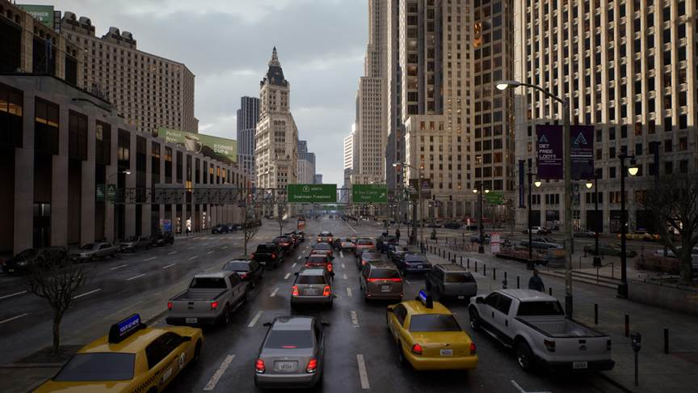
Games (real-time rendering)
Lumen: Real-time Global Illumination in Unreal Engine 5
https://advances.realtimerendering.com/s2022/index.html
Notes:
Lumen is Unreal Engine 5’s fully dynamic global illumination and reflection system, scaling from next generation console games to high-end PC visualizations. This talk will dive into how Lumen works, from software ray tracing with signed distance fields, to virtualized surface caching, hardware ray tracing, final gathering, and reflections. We’ll also show how Lumen solved indirect lighting in a large-scale procedural city in ‘The Matrix Awakens’, including an emissive-only night mode.
https://advances.realtimerendering.com/s2022/index.html

Slide 21
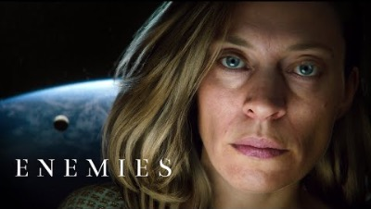
Games
Notes:
Enemies is the latest real-time short film produced by the Unity Demo Team.

Slide 22
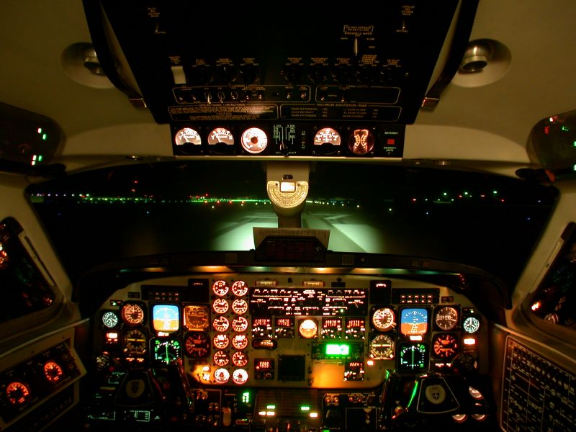
Simulation / Virtual Reality (VR)
FlightSafety International Beech 1900D Simulator, at the Orlando Training Center

Slide 23
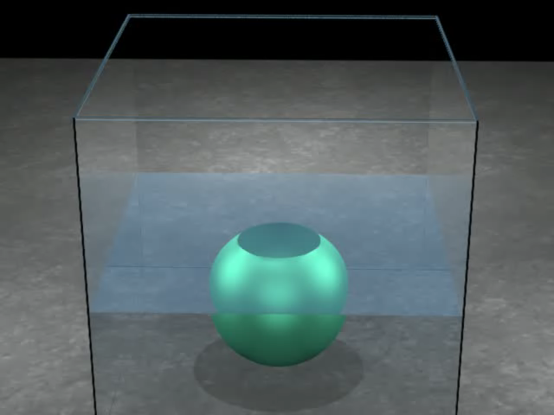
Physics-based Simulation
Robinson-Mosher, Shinar, Gretarsson, Su, and Fedkiw, "Two-way Coupling of Fluids to Rigid and Deformable Solids and Shells", SIGGRAPH 2008

Slide 24
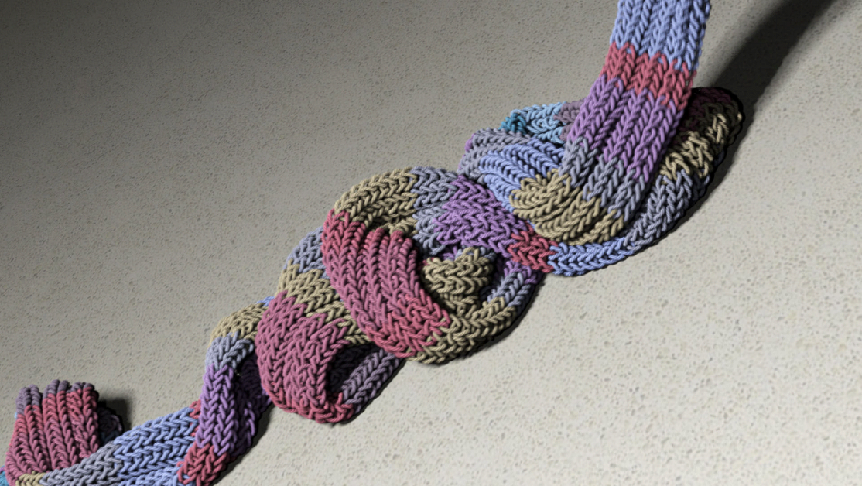
Physics-based Simulation
Kaldor, Doug James, and Marschner, SIGGRAPH2008
SIGGRAPH’21 Achievement Award

Slide 25
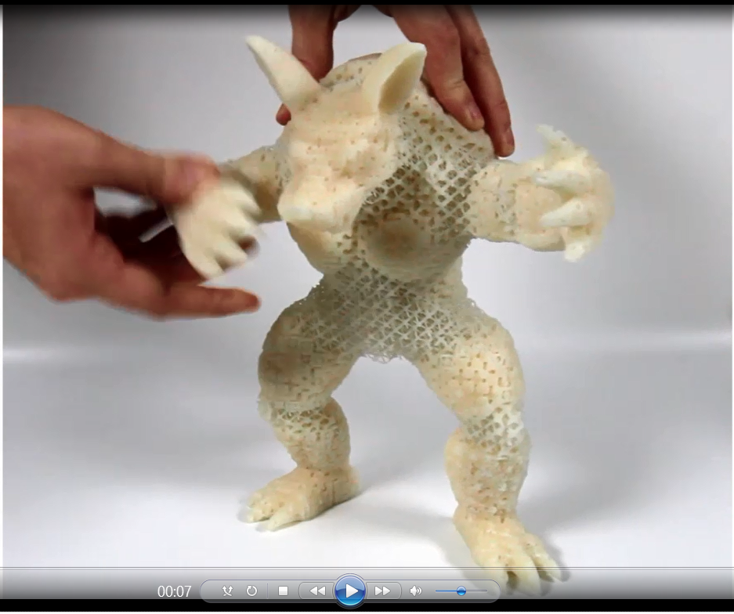
3D Printing/Fabrications
Deformable objects with spatially varying elasticity, Schumacher et al., SIGGRAPH’15
~4:00
Notes:
We propose a method for fabricating deformable objects with spatially varying elasticity using 3D printing. Using a single, relatively stiff printer material, our method designs an assembly of small-scale microstructures that have the effect of a softer material at the object scale, with properties depending on the microstructure used in each part of the object. We build on work in the area of metamaterials, using numerical optimization to design tiled microstructures with desired properties, but with the key difference that our method designs families of related structures that can be interpolated to smoothly vary the material properties over a wide range. To create an object with spatially varying elastic properties, we tile the object's interior with microstructures drawn from these families, generating a different microstructure for each cell using an efficient algorithm to select compatible structures for neighboring cells. We show results computed for both 2D and 3D objects, validating several 2D and 3D printed structures using standard material tests as well as demonstrating various example applications.

Slide 26
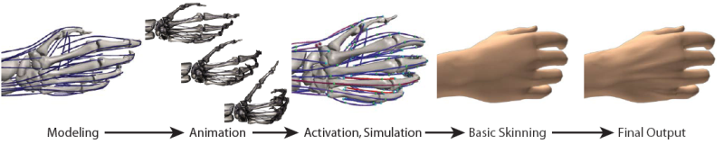
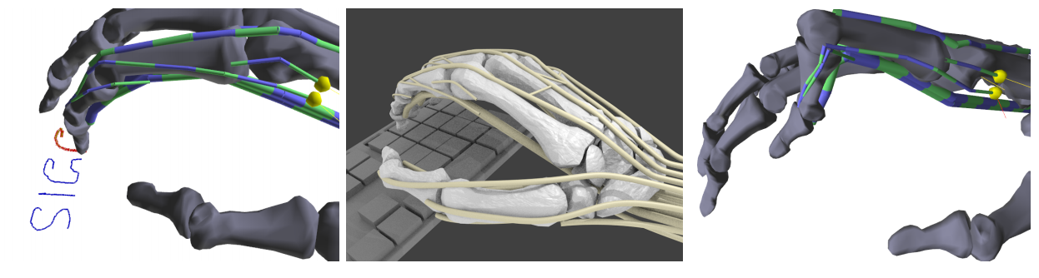
Musculotendon Simulation of Hand
Shinjiro Sueda et al., SIGGRAPH 2008, SIGGRAPH 2015
Movie (goto 1:15)
simulate clinical
conditions
https://youtu.be/EXJakVtwEfc
Notes:
Jump to 1:15 of the video!
Our biomechanical simulation and control framework can model the human hand performing tasks such as writing (a-b), and typing on a keyboard (c). We can also simulate clinical conditions such as boutonniere deformity (鈕扣孔式變形) (d) by cutting a tendon insertion.
https://youtu.be/EXJakVtwEfc

Slide 27
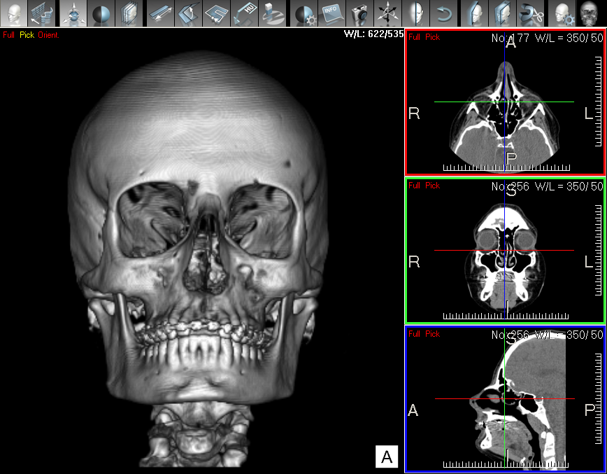
Medical Imaging
MedicView

Slide 28
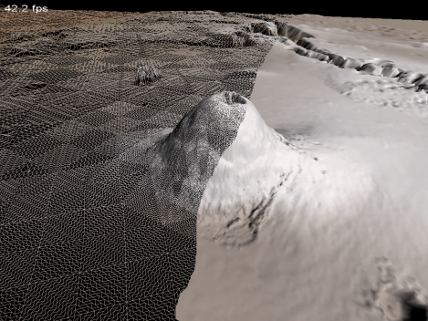
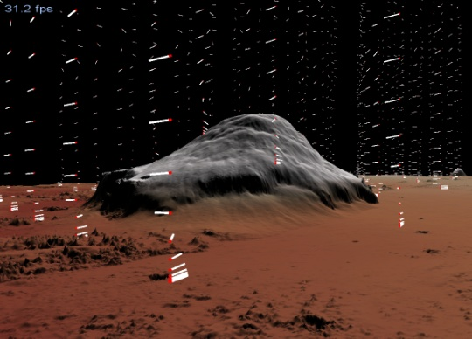
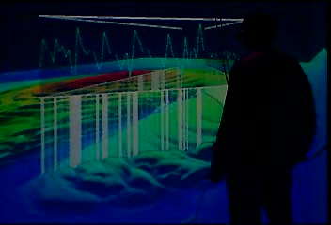
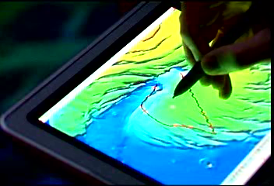
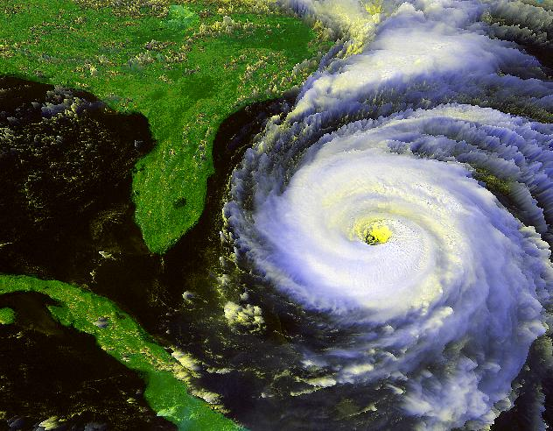
Scientific Visualization
Mars Data Visualization
Weather Data Visualization

Slide 29
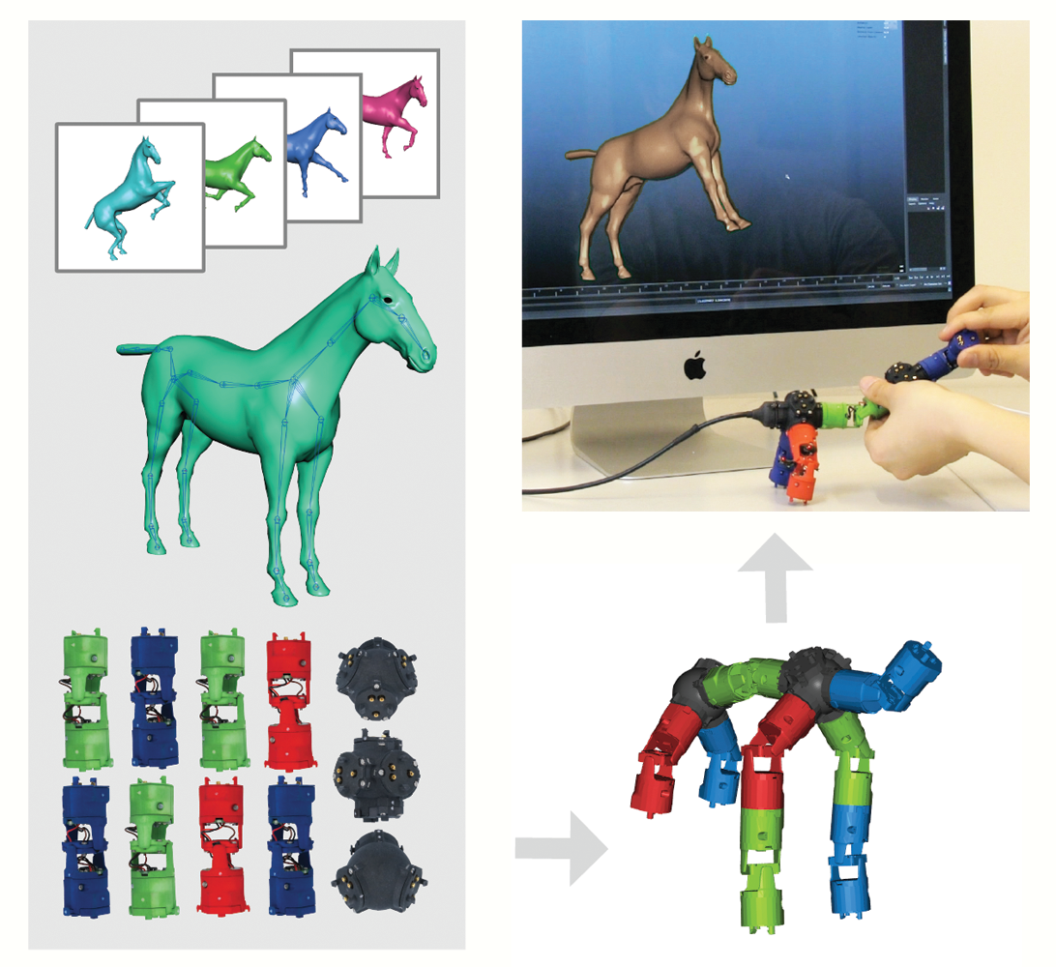
Human Computer Interaction
Rig Animation with a Tangible and Modular Input Device, SIG’16

Slide 30
More beyond you thought...
Google or Youtube “SIGGRAPH 2022”
SIGGRAPH Asia 2021 Paper Trailer https://youtu.be/kuQ2c_FAOIk
SIGGRAPH 2022 Technical Paper Preview https://youtu.be/sK2EZE617pY

